Slide 1
David Thejl-Clayton Gathering CTI - Obsidian

Slide 2




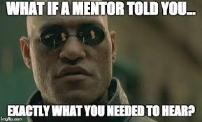
A little about Me…
British living in Denmark
Senior Advisor
Blogger
Open source
Teaching/Mentoring

Slide 3




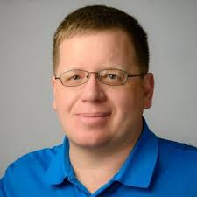
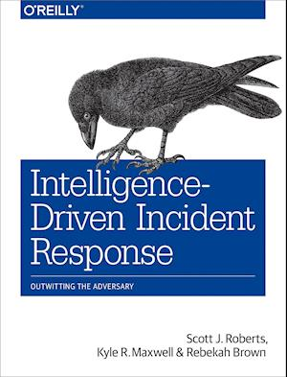
My life in CTI/Cyberz
Intelligence Driven
2017
2018
2019
2020
2020
2021
IOC’s, Threat feeds, Automation
Threat Intelligence Committee
Moved to Combitech

Slide 4
My life at Combitech
Purple Teaming
CTI
Incident Response
Detection Engineering
TIBER
Advisory

Slide 5
What is CTI (Cyber threat intelligence?)
When we talk about Threat Intelligence, it is important to remember what Threat Intelligence actually is!
Threat Data
Indicators (IP, Domain, etc)
Data about threats others have seen but without context.
How can we use this? Why is it important to us?
A long list of IP’s which are on a block list, is it useful to us?

Slide 6
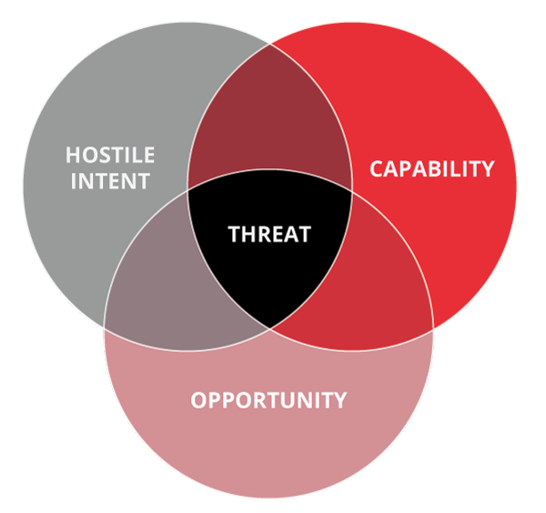
What is Threat Data
101.24.100.101
Is this something we should act on?
?
?
There is something missing before we can take a decision on how to treat this data….
?

Slide 7
Threat Intelligence
For Threat Intelligence to be valuable it must:
Have context
Be relevant
To achieve this you need to take threat data and apply the context:
This IP address has been seen hosting a ransomware payload and this actor is known to target our sector.

Slide 8
What is Threat Intelligence
101.24.100.101
TTPs Revil
C2 Framework
Is this something we should act on?
Ransomware
Yes, we know that REvil is targetting our sector
TTPs Revil
Public facing vuln

Slide 9
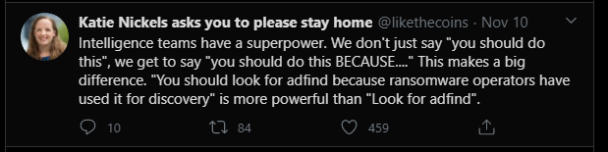

Slide 10
How to gather CTI?
Read everything that you can...
News
Blogs
Twitter
Reports
Decide on what you want to focus on, bring your own context…
Ransomware gangs?
Malware variants?
Sector specific attacks?

Slide 11

What then?
Reading articles is great, but how can you remember it all?
How can you make your knowledge more operational and useful?
You are going to need a 2nd brain!

Slide 12
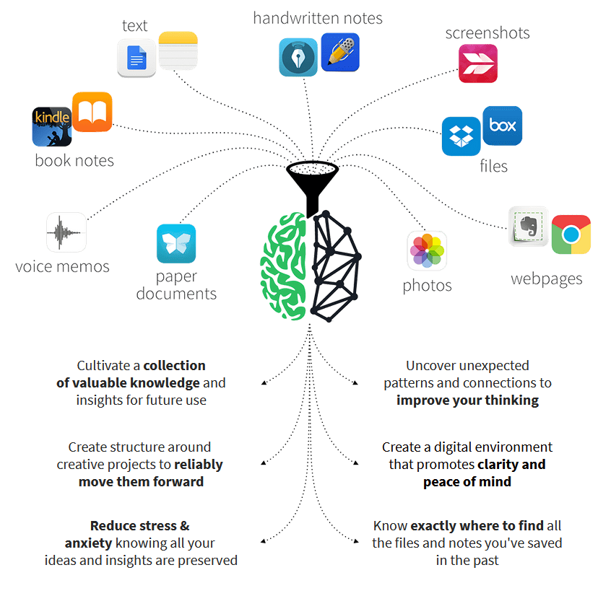
2nd brain
The idea is that we consume so much information everyday that we simply cannot remember it all...
So why not spend a few extra minutes indexing it!
Source: http://chuckfrey.com/how-building-second-brain-blew-thinking/

Slide 13
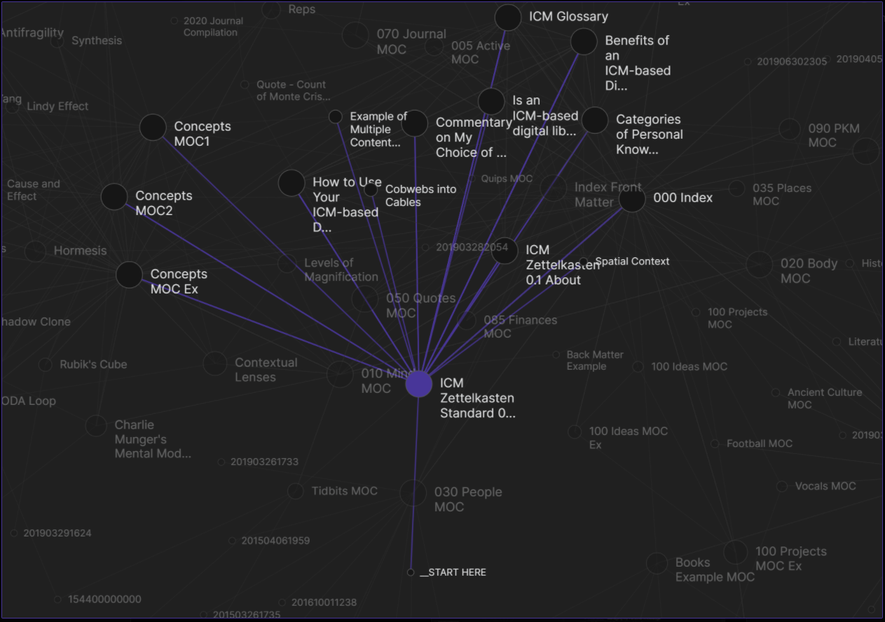
Obsidian - Demo

Slide 14
What can you do now?
Download Obsidian!
Find your context
Find your resources (Blogs etc)
Get indexing!
Templates that I use:-
https://github.com/Combitech-DK/public/tree/main/obsidian/templates

